Slide 1
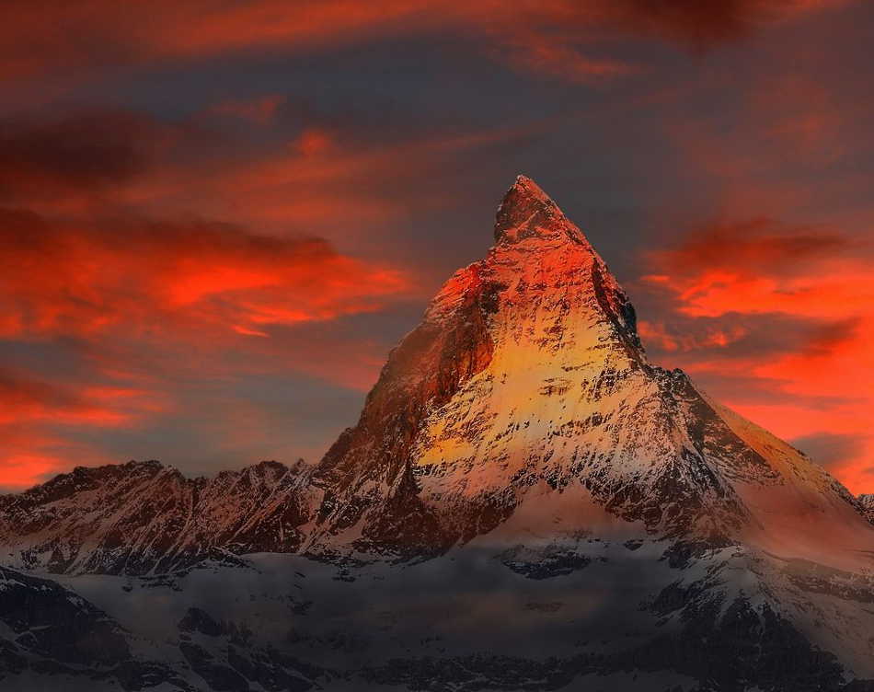
Hymn of Heaven

Slide 2
C Csus C
How I long to breathe the air of Heaven
Am F G
Where pain is gone and mercy fills the streets
C F C G Am
To look upon the one who bled to save me
F G C Csus C
And walk with Him for all eternity

Slide 3
C F G C
Oh, There will be a day When all will bow before Him
C F Am G
There will be a day When death will be no more
C F G C G Am
Standing face to face With He who died and rose again
F G C
Holy holy is the Lord

Slide 4
C F C
Every prayer we prayed in desperation
Am F G
The songs of faith we sang through doubt and fear
C F C G Am
In the end we’ll see that it was worth it
F G C Csus C
When He returns to wipe away our tears

Slide 5
C F G C
Oh, There will be a day When all will bow before Him
C F Am G
There will be a day When death will be no more
C F G C G Am
Standing face to face With He who died and rose again
F G C
Holy holy is the Lord

Slide 6
C F C
On that day we join the resurrection
Am F G
And stand beside the heroes of the faith
C F C G Am
With one voice a thousand generations
F G C
Sing “worthy is the Lamb who was slain”

Slide 7
C F C
On that day we join the resurrection
Am F G
And stand beside the heroes of the faith
C F C G Am
With one voice a thousand generations
F G C
Sing “worthy is the Lamb who was slain”
F G C Csus C
“Forever He shall reign”

Slide 8
C F G C
So let it be today we shout the hymn of Heaven
C F Am G
With angels and the Saints we raise a mighty roar
C F G C G Am
“Glory to our God” who gave us life beyond the grave
F G C
Holy holy is the Lord

Slide 9
C F G C
So let it be today we shout the hymn of Heaven
C F Am G
With angels and the Saints we raise a mighty roar
C F G C G Am
“Glory to our God” who gave us life beyond the grave
F G Am
Holy holy is the Lord
F G Am
Holy holy is the Lord
F G C Csus C
Holy holy is the Lord
END

Slide 10
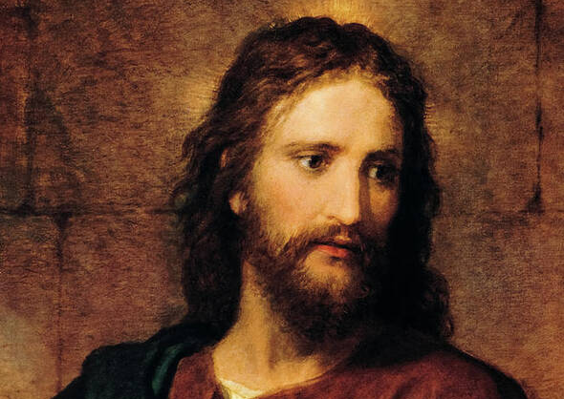
Jesus Paid It All

Slide 11
C
I hear the Savior say,
G C
Thy strength indeed is small,
Am F
Child of weakness, watch and pray,
C G C
Find in Me thine all in all

Slide 12
C Am
Jesus paid it all
C G
All to Him I owe
C F
Sin had left a crimson stain
C G C
He washed it white as snow

Slide 13
C
Lord, now indeed I find
G C
Thy pow'r and Thine alone,
Am F
Can change the leper's spots
C G C
And melt the heart of stone

Slide 14
C Am
Jesus paid it all
C G
All to Him I owe
C F
Sin had left a crimson stain
C G C
He washed it white as snow

Slide 15
C
And when, before the throne
G C
I stand in Him complete
Am F
Jesus died my soul to save
C G C
My lips shall still repeat

Slide 16
C Am
Jesus paid it all
C G
All to Him I owe
C F
Sin had left a crimson stain
C G C
He washed it white as snow

Slide 17
C Csus
Oh praise the one who paid my debt
C Csus
And raised this life up from the dead
C F
Oh praise the one who paid my debt
Dm F
And raised this life up from the dead

Slide 18
C Am
Jesus paid it all
C G
All to Him I owe
C F
Sin had left a crimson stain
C G C
He washed it white as snow
END

Slide 19
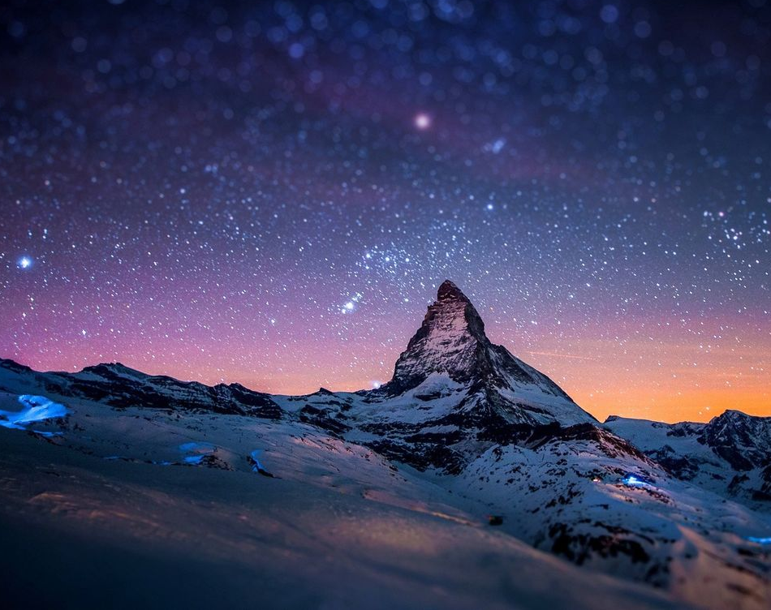
Goodness of God

Slide 20
C F C
I love You Lord Oh, Your mercy never fails me
G Am F Gsus G
All my days, I've been held in Your hands
Am F
From the moment that I wake up
C G Am
Until I lay my head
F G Csus4 C
I will sing of the goodness of God

Slide 21
F C
All my life You have been faithful
F C G
All my life You have been so, so good
F C G Am
With every breath that I am able
F G Csus4 C
I will sing of the goodness of God

Slide 22
C F C
I love Your voice You have led me through the fire
G Am F Gsus4 G
In my darkest night, You were close like no other
Am F
I've known You as a father
C G Am
I've known You as a friend
F G C
I have lived in the goodness of God

Slide 23
F C
All my life You have been faithful
F C G
All my life You have been so, so good
F C G Am
With every breath that I am able
F G Csus4 C
I will sing of the goodness of God

Slide 24
C F G C
Your goodness is running after, it’s running after me
C F G C
Your goodness is running after, it’s running after me
C F
With my life laid down, I’m surrendered now,
G Am
I give You everything
C F G C
Your goodness is running after, it’s running after me

Slide 25
F C
All my life You have been faithful
F C G
All my life You have been so, so good
F C G Am
With every breath that I am able
F G Am
I will sing of the goodness of God
F G Csus4 C
I will sing of the goodness of God
END

Slide 26

Eagles Wings

Slide 27
Am / D / G / C
Am / D / G / C
Am D G C
Here I am waiting Abide in me I pray
Am D G
Here I am longing for You
Am D G C
Hide me in Your love, Bring me to my knees
Am D G C D
May I know Jesus more and more

Slide 28
G C
Come live in me
Am D
All my life, take over
G C
Come breathe in me
Am D G
And I will rise on Eagles Wings

Slide 29
Am D G C
Here I am waiting, abide in me I pray
Am D G
Here I am longing for You
Am D G C
Hide me in Your love, bring me to my knees
Am D G C D
May I know Jesus more and more

Slide 30
G C
Come live in me
Am D
All my life, take over
G C
Come breathe in me
Am D G
And I will rise on Eagles Wings

Slide 31
G C
Come live in me
Am D
All my life, take over
G C
Come breathe in me
Am D G
And I will rise on Eagles Wings

Slide 32
Am D G C
Here I am waiting, abide in me I pray
Am D G
Here I am longing for You
Am D G C
Hide me in Your love, bring me to my knees
Am D G C D
May I know Jesus more and more
END

Slide 33
It Is Well

Slide 34
G C D G
When peace like a river attendeth my way
Em A D
When sorrows like sea billows roll
G C A D
Whatever my lot, Thou hast taught me to say
G C D G
It is well, it is well with my soul

Slide 35
G D
It is well (it is well)
D G
With my soul (with my soul)
C G D G
It is well, it is well with my soul

Slide 36
G C D G
Though Satan should buffet, though trials should come
Em A D
Let this blest assurance control
G C A D
That Christ has regarded my helpless estate
G C D G
And has shed His own blood for my soul

Slide 37
G D
It is well (it is well)
D G
With my soul (with my soul)
C G D G
It is well, it is well with my soul

Slide 38
G C D G
My sin - O, the bliss of this glorious thought
Em A D
My sin - not in part but the whole
G C A D
Is nailed to the cross and I bear it no more
G C D G
Praise the Lord, praise the Lord, O my soul

Slide 39
G D
It is well (it is well)
D G
With my soul (with my soul)
C G D G
It is well, it is well with my soul

Slide 40
G C D G
And, Lord haste the day when the faith shall be sight
Em A D
The clouds be rolled back as a scroll
G C A D
The trump shall resound and the Lord shall descend
G C D G
Even so - it is well with my soul

Slide 41
G D
It is well (it is well)
D G
With my soul (with my soul)
C G D G
It is well, it is well with my soul
END

